Slide 1

YSC2239 Lecture 19

Slide 2

Regularization
𝜆
Controlling the Model Complexity

Slide 3
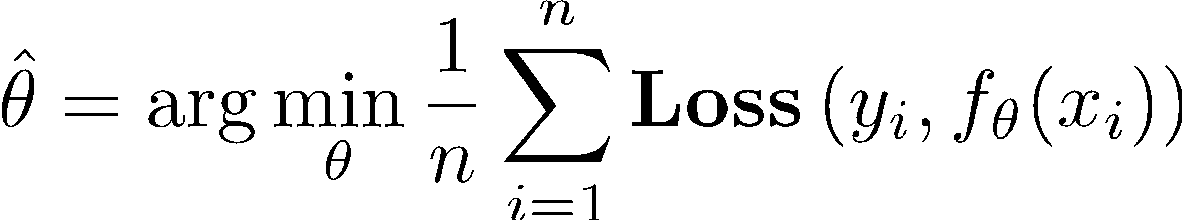

Basic Idea
Such that:
does not “overfit”
Can we make this more formal?

Slide 4

Basic Idea
Regularization Hyperparameter
Such that:
Complexity( )
How do we define this?

Slide 5
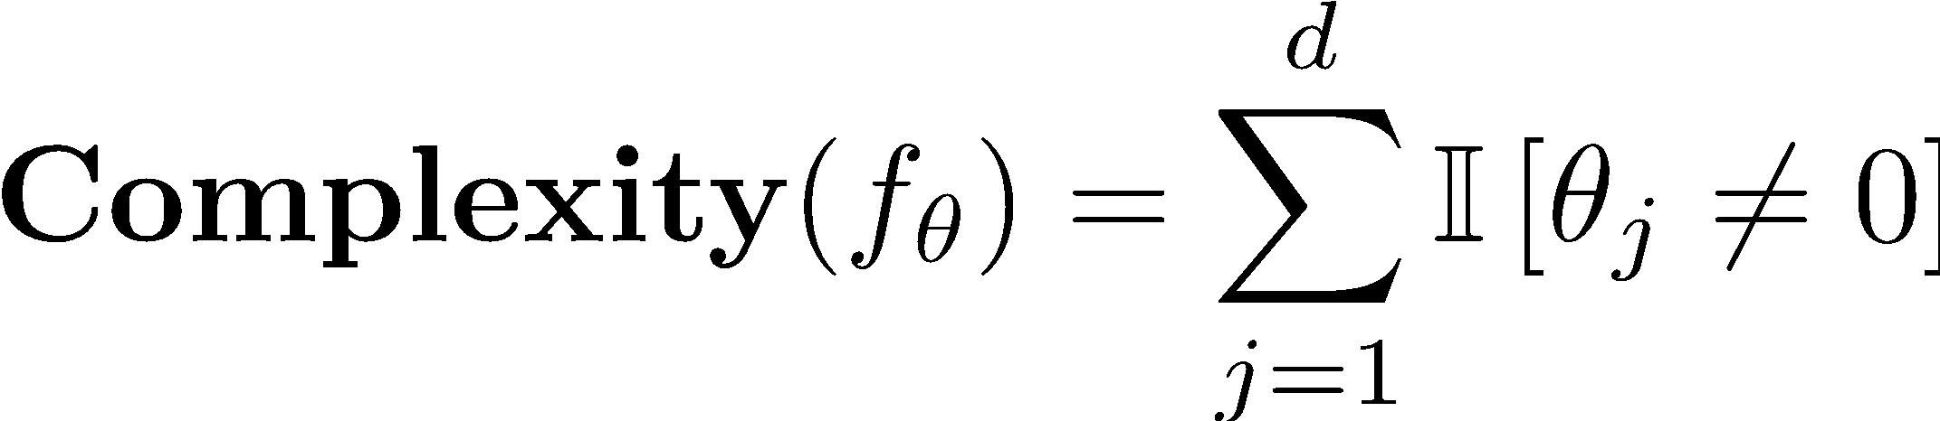
Idealized Notion of Complexity
Complexity( )
Focus on complexity of linear models:
Number and kinds of features
Ideal definition:
Why?
Number of non-zero parameters

Slide 6
Ideal “Regularization”
Find the best value of θ which uses fewer than β features.
Such that:
Need an approximation!
Combinatorial search problem – NP-hard to solve in general.

Slide 7
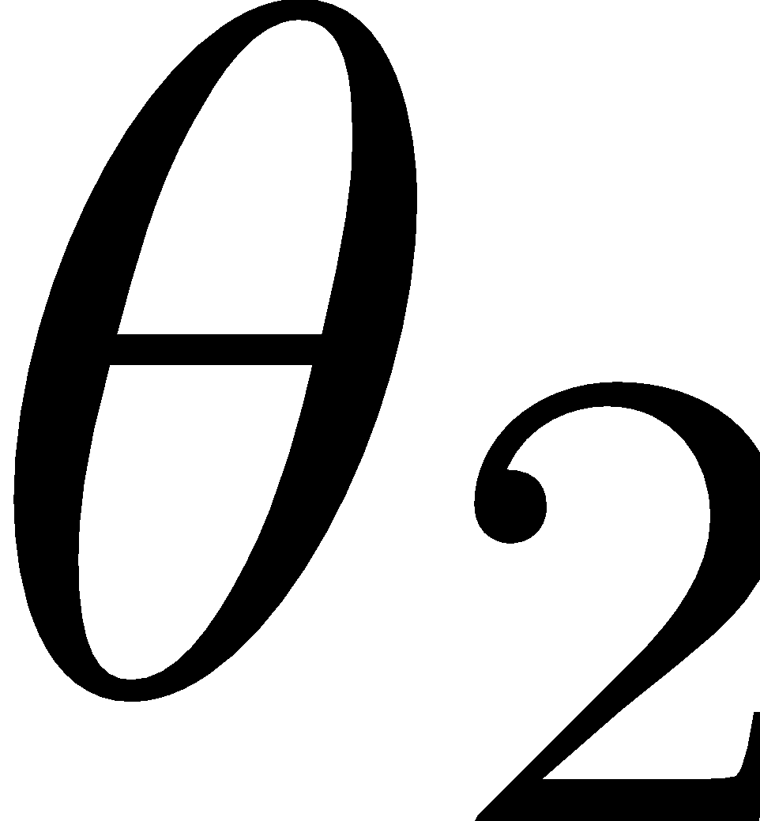


Norm Balls
L⁰ Norm Ball

Slide 8
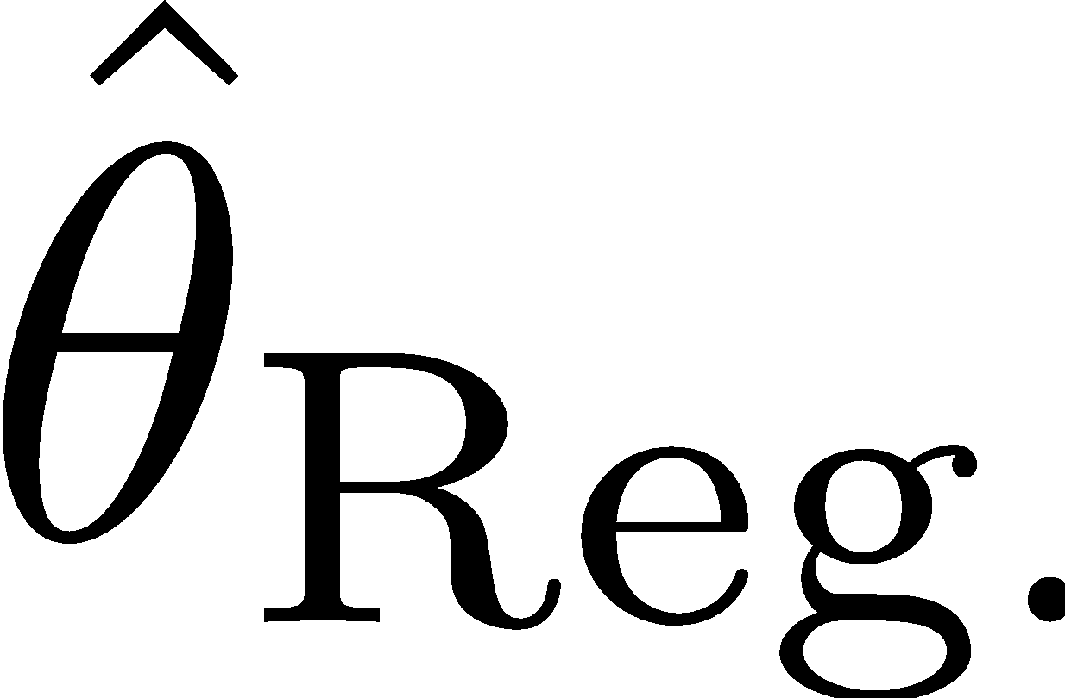
Norm Balls
Hard to solve problem
L⁰ Norm Ball

Slide 9
Norm Balls
L⁰ Norm Ball
Can we construct an approximation?

Slide 10
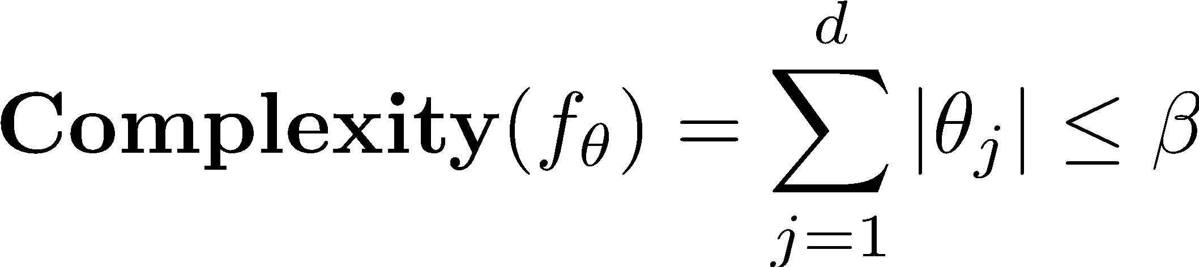
Norm Balls
L¹ Norm Ball

Slide 11
Norm Balls
L¹ Norm Ball

Slide 12
Norm Balls
L¹ Norm Ball

Slide 13
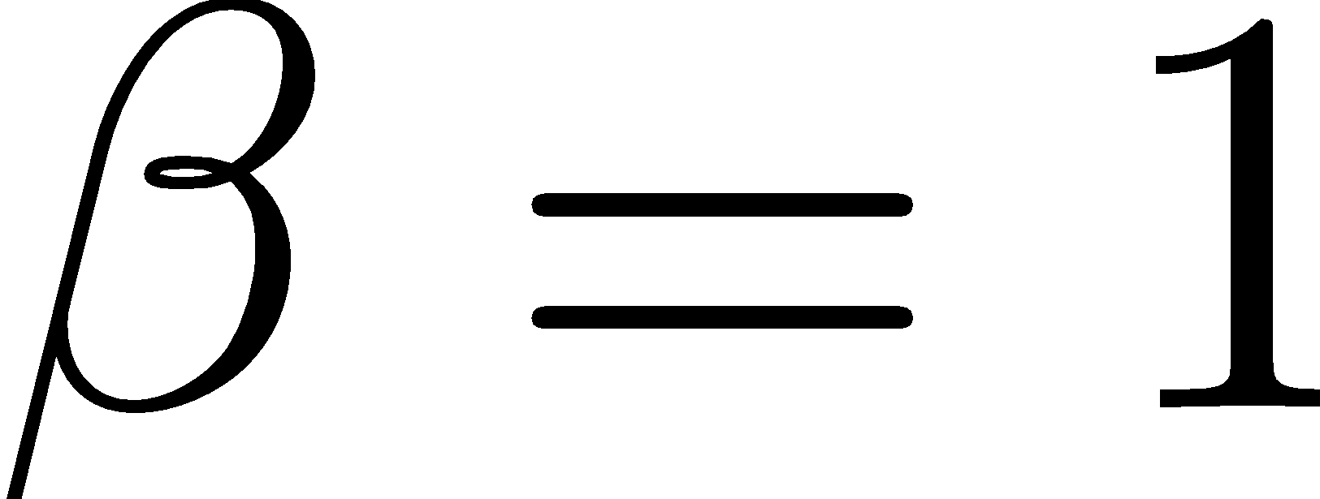
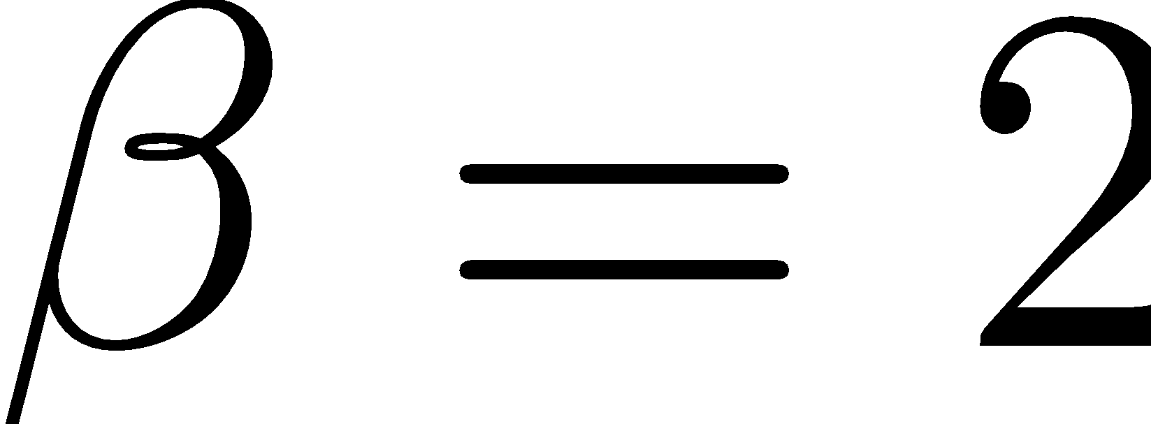
Norm Balls
L¹ Norm Ball

Slide 14
Norm Balls
L¹ Norm Ball

Slide 15
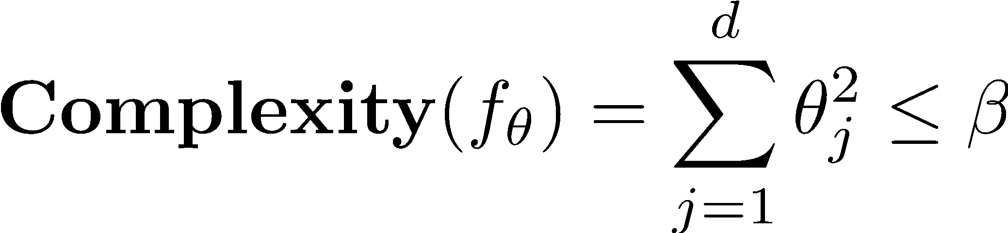
Norm Balls
L² Norm Ball

Slide 16
Norm Balls
L² Norm Ball

Slide 17
Norm Balls
L² Norm Ball

Slide 18
Norm Balls
L² Norm Ball

Slide 19
L⁰ Norm Ball
L¹ Norm Ball
L² Norm Ball
Ideal for Feature Selection but combinatorically difficult to optimize
Encourages sparse solutions
Spreads weight over features, but does not encourage sparsity

Slide 20
Ridge and LASSO Regression

Slide 21

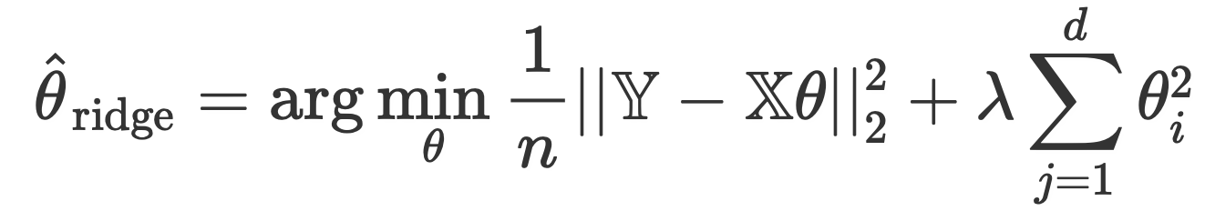
Ridge Regression
“Ridge Regression” is a term for the following specific combination of model, loss, and regularization:
Model:
Loss: Squared loss
Regularization: L2 regularization
The objective function we minimize for Ridge Regression is average squared loss, plus an added penalty:

Slide 22
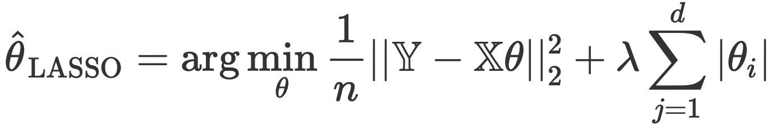
LASSO Regression
“LASSO Regression” is a term for the following specific combination of model, loss, and regularization:
Model:
Loss: Squared loss
Regularization: L1 regularization
The objective function we minimize for LASSO Regression is average squared loss, plus an added penalty:

Slide 23
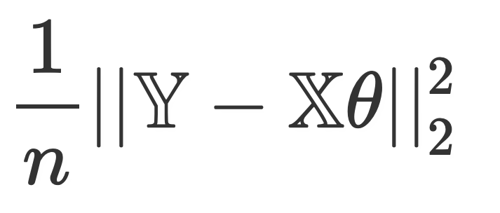
Summary of Regression Methods
Name | Model | Loss | Reg. | Objective
OLS |  | Squared loss | None
Ridge Regression |  | Squared loss | L2
LASSO |  | Squared loss | L1

Slide 24



Hyperparameters vs. Parameters
Parameters are facts about the world that we want to estimate
Commonly denoted by
Statistics are the estimators of the parameters, based on our data
Commonly denoted by
Hyperparameters are design choices we make in our modeling process that affect our model, but do not directly come from the data
examples: regularization hyperparameter, degree of polynomial
Commonly denoted by

Slide 25
Demo

